Slide 1

LWC
From “What the hell is that?!” to “Why did he write it like that?!”

Slide 2

AGENDA
Mmmm, JavaScript 🥲
Warm-up exercises
LWCs.
Finally. The project
* Prepare yourself to struggle a lot.

Slide 3
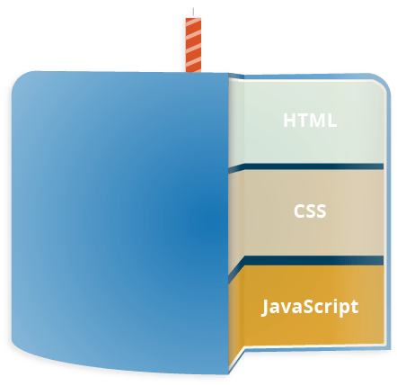
JavaScript
JavaScript – is
a programming language
allows you to implement complex features on web pages
displaying timely content updates,
interactive maps
animated 2D/3D graphics
scrolling video jukeboxes
The third layer of the layer cake of standard web technologies, two of which are HTML and CSS.

Slide 4



HTML + CSS + JS = ❤️
HTML is the markup language that we use to structure and give meaning to our web content
CSS is a language of style rules that we use to apply styling to our HTML content
JavaScript is a scripting language that enables you to create dynamically updating content, animate images

Slide 5
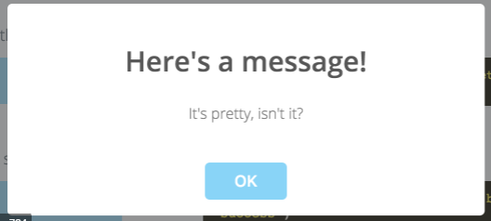
HTML
*Javascript - closes the window on “OK” click
CSS. Styling

Slide 6
JS Data Types
We always work with some data. Numbers, characters, Dates, etc…
We need to store the data somehow, so therefore every language have data types.
The same for JS.
In JS there’s 2 types…
Read here
Notes:
We all work with some data. Nubmers, characters, Dates, etc…
In programming we need to store this data somehow, so this is why we have different data types.

Slide 7
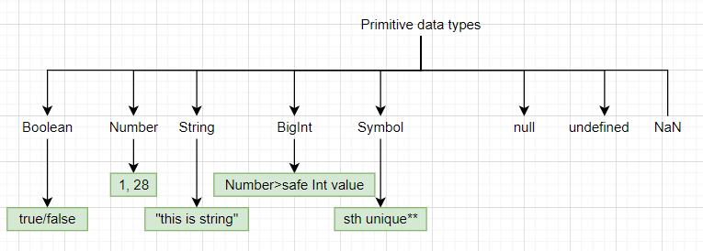
Primitive data types

Slide 8
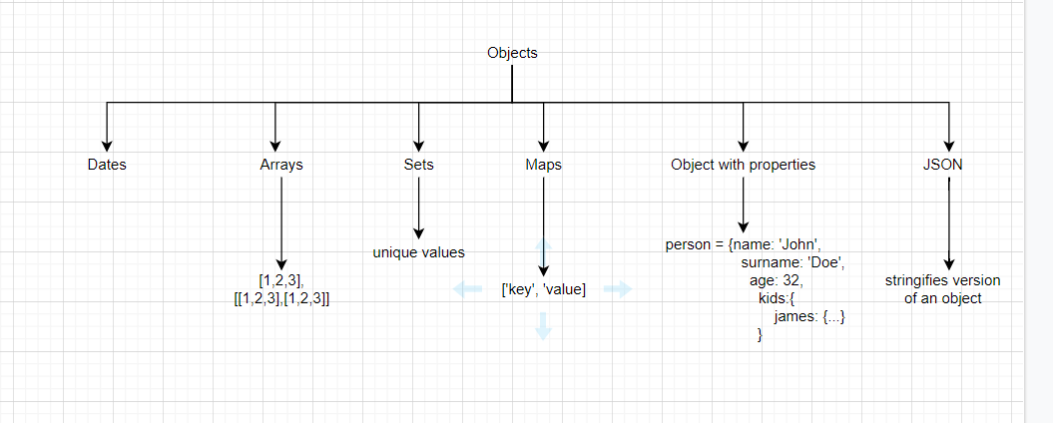
Objects

Slide 9
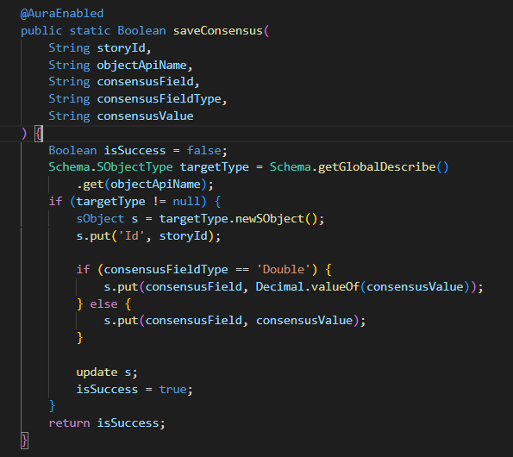
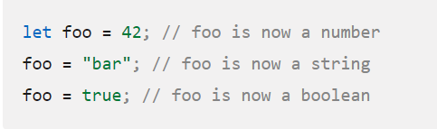

Statically vs Dynamically typed languages
Statically:
Dynamically:
JS is one of these languages
Notes:
The main difference between statically and dynamically typed languages is that the type of a variable is known at compile time. A language is dynamically typed if the type of a variable is checked during run-time.

Slide 10
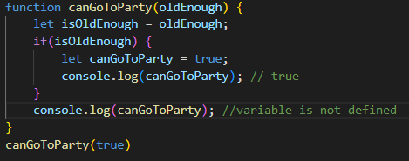
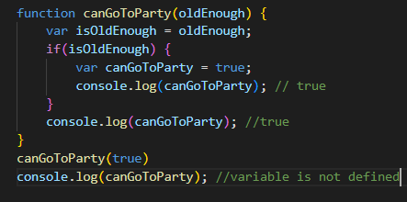
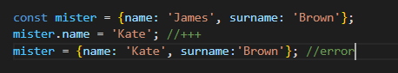
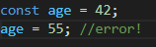
How to declare variables
let – block-scoped local variable
var – function-scoped or globally-scoped variable
const – block-scoped local variable. Value cannot be mutated

Slide 11
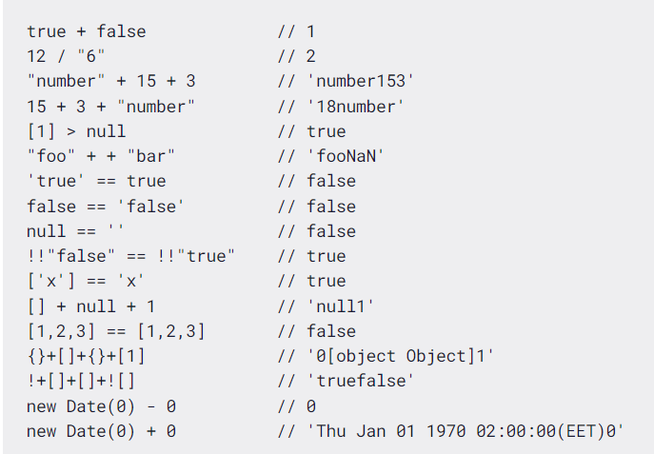
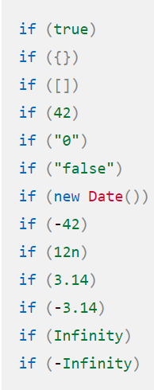
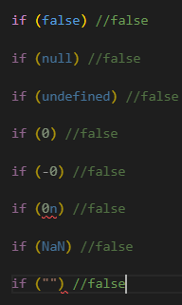
That’s not all…
Truthy
Falsy
Type coercion
Read here
Read here
Read here

Slide 12


Slide 13

Let’s talk arrays
Let numberBag = [1, 3, 6, ‘cat’, undefined]
Array functions
numberBag
.forEach(elem => do sth)
iterates thru each element
.filter(elem => elem === 1)
Filters and returns only elems that satisfy the condition.
.map(elem => //transform)
Returns new array
… a loot of other functions.
1
6
3
cat
undefined
Read here
numberBag[0] = 1, numberBag[2] = 6

Slide 14
Practice Time
Find Exercises folder and open ArrayFunctions.js file in VSCode

Slide 15
Finally. LWC

Slide 16
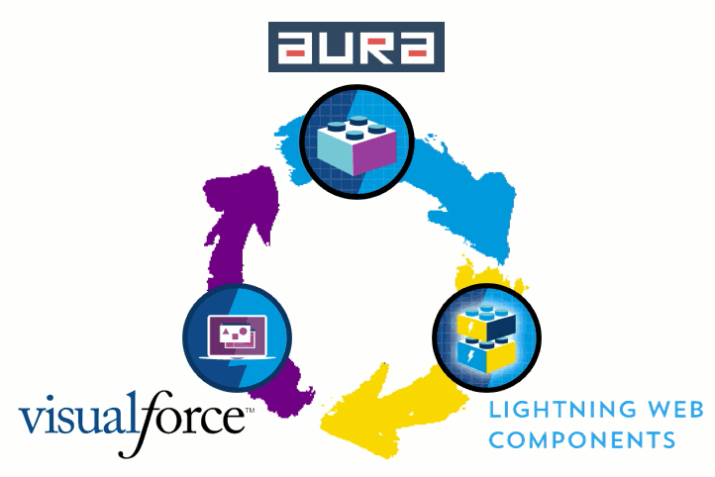
What is LWC and why do we need it?
What?
Salesforce’s implementaion of lightweight frameworks built on base of Web Components to create UI in Salesforce
Why?
Supports ES6.(promises, arrow functions, etc..
Allows to attract more frontend devs from external market.
Performance improvents
Improved ways to work with SF data(LDS)
Unit testing with JEST
Source

Slide 17
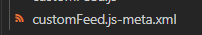
Component structure
.css file(optional) -> style
.html file -> skeleton
.js file -> component logic
.js-meta.xml -> configuration file

Slide 18
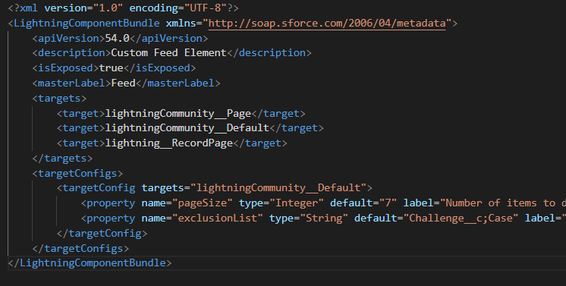
Component structure. More on .js-meta.xml
.js-meta.xml -> configuration file
Allows to define where this cmp can be displayed in Salesforce(Tabs, Experience cloud, etc..)
Allows to predefine some configurable component parameters

Slide 19
Project time!

Slide 20
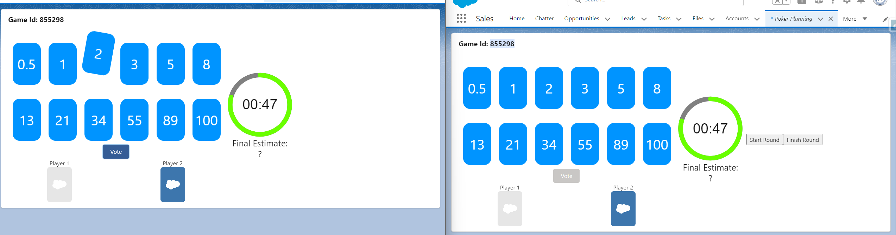
2 different users

Slide 21
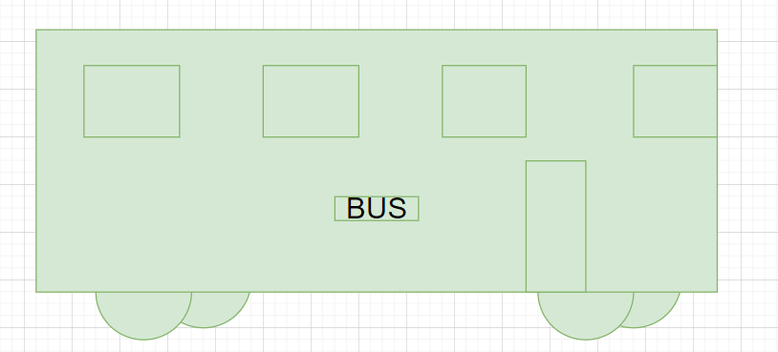
Components Architecture. With readability and reusability in mind
All the code can be easily stored in a single component
What if we need to reuse a piece of functionality?
What if this component so big, that it has 2k+ lines of html and js code?

Slide 22
Components Architecture. With readability and reusability in mind
Think of LEGO blocks.

Slide 23
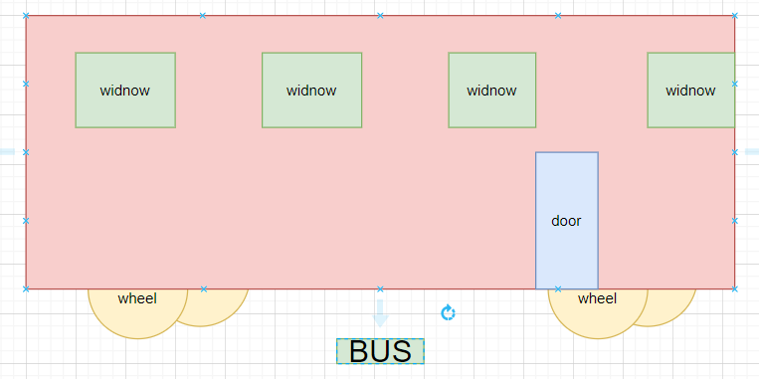
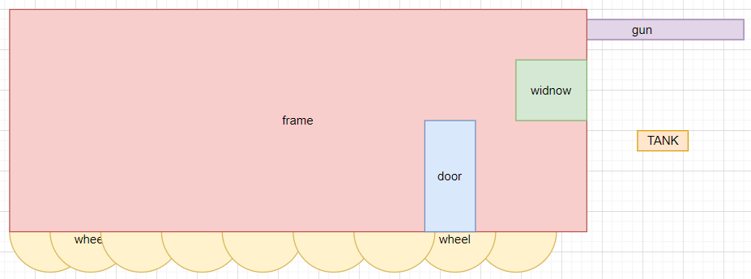
Components Architecture. With readability and reusability in mind
Before you start coding,
think the components architecture first:
- reusability
- scalability
- readability
- support
Always!

Slide 24
Break. 10 mins

Slide 25
Communication in LWC
Parent-Child communication -> child exposes public properties/methods that parent can control and call
Child-Parent communication -> child – parent communication. Completed with Custom events.
Communication between unrelated components
Lightning message service – communication between components that are not connected but on the same page(Not covered in this tutorial)
Platform Events – events published across whole SF instance. Any LWC can subscribe to it
Read here
Read here
Read here
Read here

Slide 26
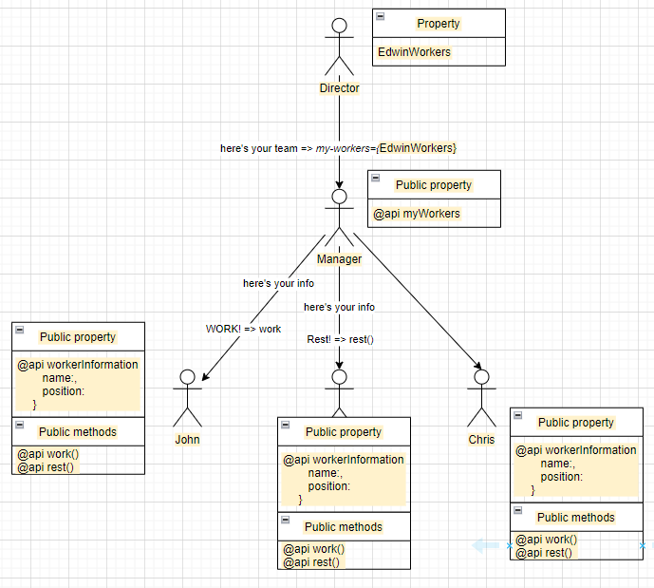
Communication in LWC
Public properties/methods - sort of a communication between parent and child
Read here

Slide 27
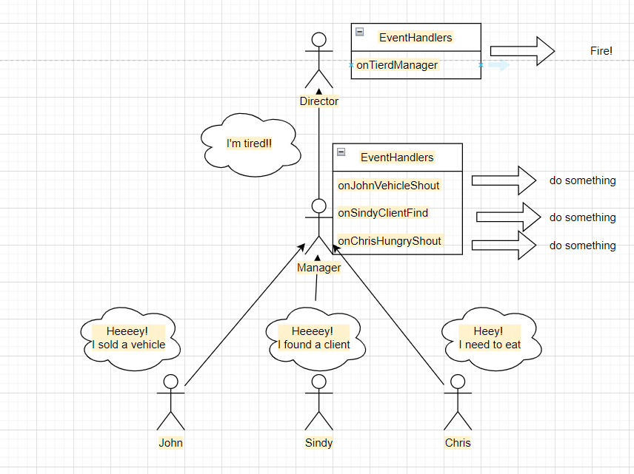
Communication in LWC
Custom events - sort of a communication between child and parent
Read here

Slide 28
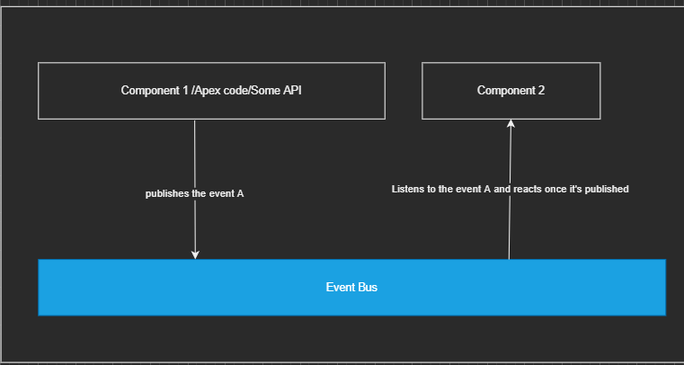
Communication in LWC
Platform events - allows for communication between components, platforms
Read here

Slide 29
Field reactivity
If the value of field, that is used in the template, changes -> the component rerenders and displays a new value on a screen
How is it tracked? With “===“ comparison of the old and new values
Read here

Slide 30
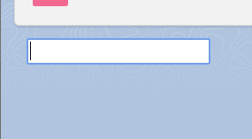
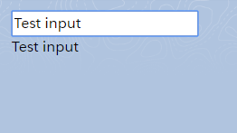
Field reactivity
Write ‘Test input’
Old.reactiveText === new.reactiveText
Save input value to the ‘reactiveText’ property and display it below
Values compared and new value is displayed
Read here

Slide 31
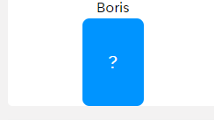

Field reactivity
It complicates when Objects come into play
===(true, because of reference)
Read here

Slide 32
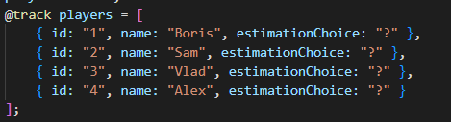
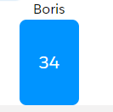
Field reactivity
@track property
Once annotated with @track ->
LWC tracks internal changes of {}, and []
*Don’t support Date, Set, Map
Read here

Slide 33
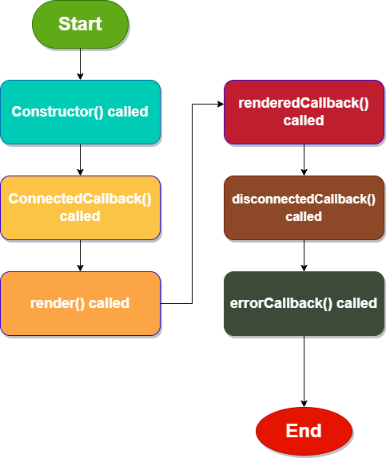
Lifecycle hooks
Every component has its own lifecycle
Lightning Framework manages this lifecycle. It’s responsible for the component's creation, inserting/removing to the DOM and rendering
Lifecycle Hooks are callback methods that are triggered at a specific phase of a component instance’s lifecycle.
Read here

Slide 34

Lifecycle hooks
Constructor()
connectedCallback()
render()
renderedCallback()
disconnectedCallback()
errorCallback()

